Slide 1
"SEGMENT IT" QUIZ

Slide 2
Segment It! Quiz Instructions
Goal: Identify the most appropriate image segmentation technique for each image.
How to Play:
Look at the image shown on each slide.
Read the question.
Click the segmentation technique you think works best.
You will receive immediate feedback.

Slide 3
Technique Reference (Cheat Sheet)
Thresholding – separates light and dark
Edge Detection – finds boundaries
Region-Based – groups neighboring pixels
Clustering – groups similar pixels

Slide 4
Quiz
Start Quiz

Slide 5
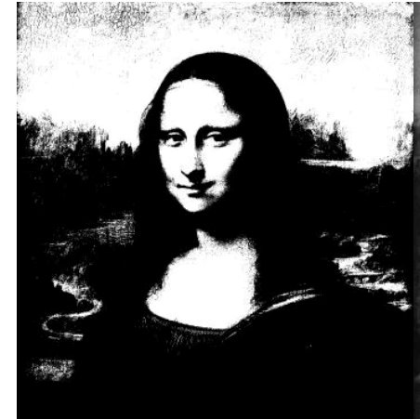
Mona Lisa
Which segmentation technique works best for this image?
Thresholding
Region Base
Edge Detection
Clustering

Slide 6
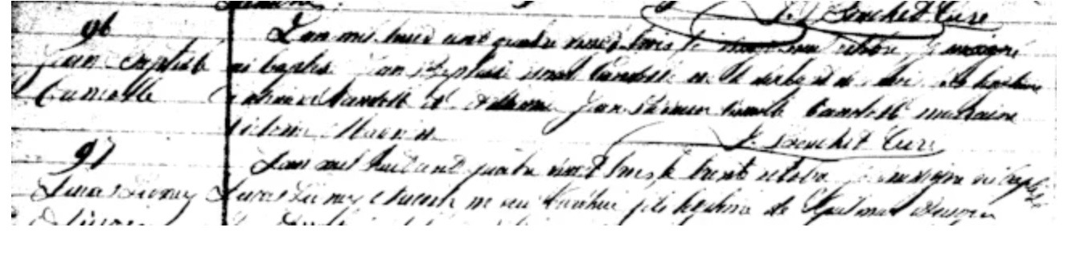
Copied document
Which segmentation techniqueworks best for this image?
Which segmentation technique works best for this image?
Thresholding
Region Base
Edge Detection
Clustering

Slide 7
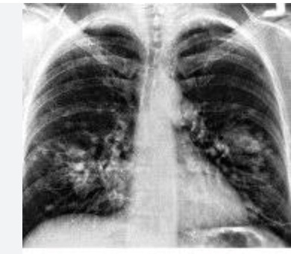
Question 2
Lungs
Which segmentation technique works best for this image?
Thresholding
Region Base
Edge Detection
Clustering

Slide 8
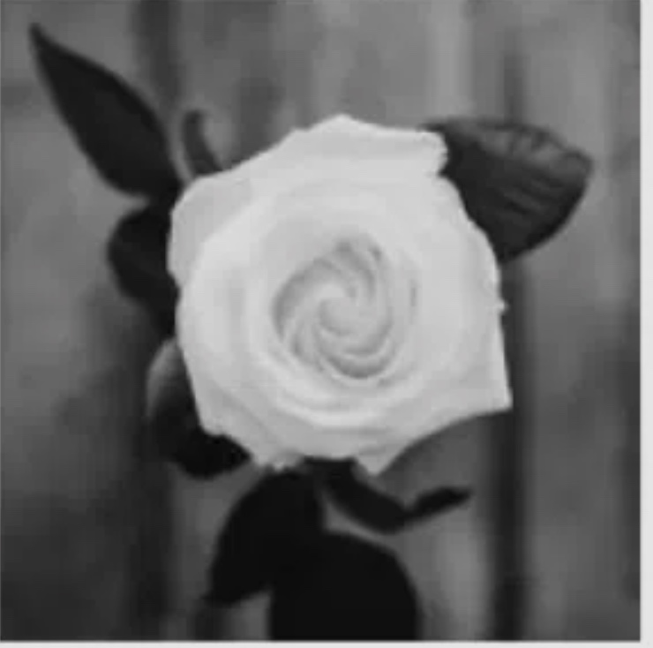
Question 2
Flower3
Which segmentation technique works best for this image?
Thresholding
Region Base
Edge Detection
Clustering

Slide 9
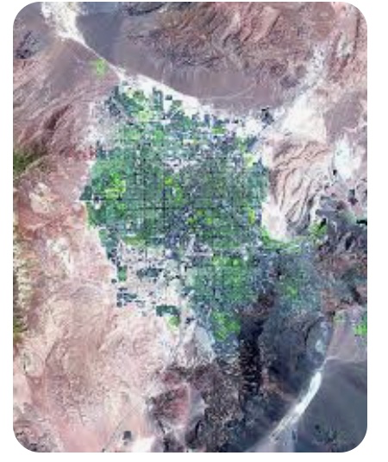
Question 2
Land
Which segmentation technique works best for this image?
Thresholding
Region Base
Edge Detection
Clustering

Slide 10
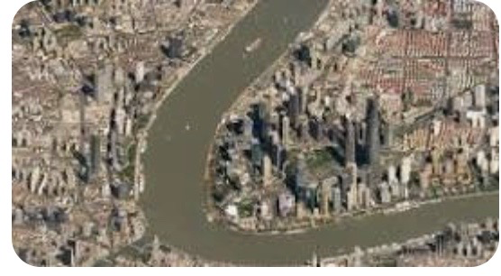
Question 2
Satellite Image
Which segmentation technique works best for this image?
Thresholding
Region Base
Edge Detection
Clustering

Slide 11
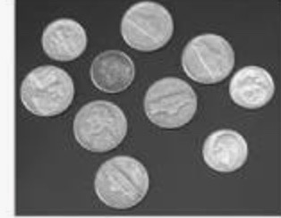
Question 2
Coins
Which segmentation technique works best for this image?
Thresholding
Region Base
Edge Detection
Clustering

Slide 12
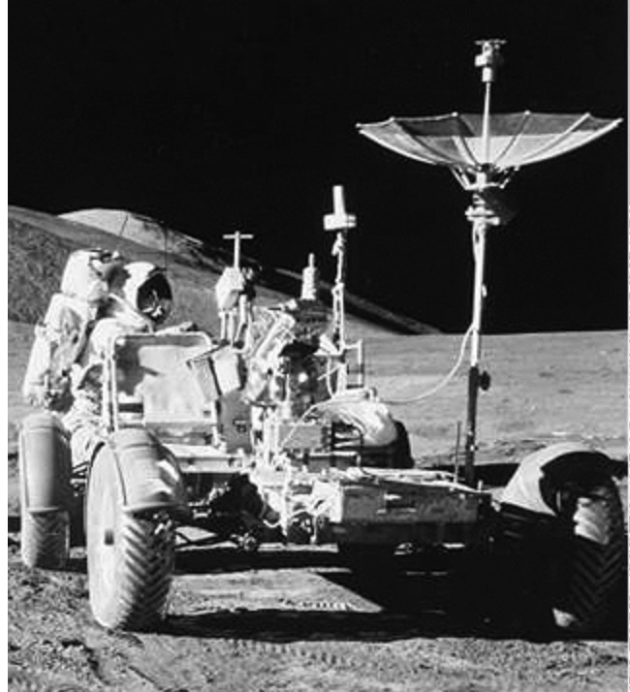
Question 2
Space
Which segmentation technique works best for this image?
Thresholding
Region Base
Edge Detection
Clustering

Slide 13

Question 2
Bar Code
Which segmentation technique works best for this image?
Thresholding
Region Base
Edge Detection
Clustering

Slide 14
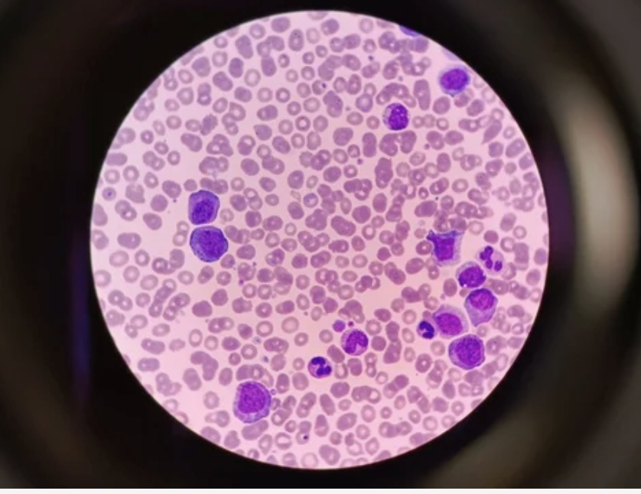
Question 2
Microscope
Which segmentation technique works best for this image?
Thresholding
Region Base
Edge Detection
Clustering

Slide 15
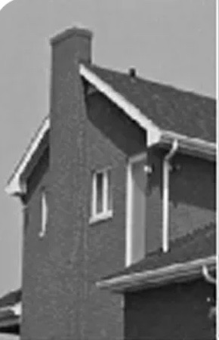
Question 2
House
Which segmentation technique works best for this image?
Thresholding
Region Base
Edge Detection
Clustering

Slide 16
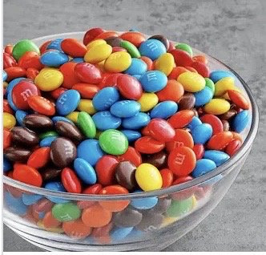
Question 2
M&Ms
Which segmentation technique works best for this image?
Thresholding
Region Base
Edge Detection
Clustering

Slide 17
Correct Feedback – Mona Lisa
Mona Lisa - This image has clear contrast and even lighting, making thresholding the best choice. Next Question

Slide 18
Correct Feedback Copied Document
Copied document - This image contains connected regions with similar intensity, making region-based segmentation the best choice. Next Question

Slide 19
Correct Feedback - Lungs
Lungs - This image has clear contrast and even lighting, making thresholding the best choice. Next Question

Slide 20
Correct Feedback - Flower
Flower - This image contains clear boundaries and sharp intensity changes, making edge-based segmentation the best choice.Next Question

Slide 21
Correct Feedback Land
Land - This image has clear contrast and even lighting, making thresholding the best choice. Next Question

Slide 22
Correct Feedback Sattelite Image
Satellite Image - This image contains multiple colors or textures that can be grouped by similarity, making clustering the best choice.Next Question

Slide 23
Correct Feedback Coins
This image has clear contrast and even lighting, making thresholding the best choice. Next Question

Slide 24
Correct Feedback Space Craft
This image contains clear boundaries and sharp intensity changes, making edge-based segmentation the best choice.Next Question

Slide 25
Correct Feedback Bar code
Bar code - his image has clear contrast and even lighting, making thresholding the best choice. Next Question

Slide 26
Correct Feedback microscope
his image contains connected regions with similar intensity, making region-based segmentation the best choice. Next Question

Slide 27
Correct Feedback House
House - This image contains clear boundaries and sharp intensity changes, making edge-based segmentation the best choice.Next Question

Slide 28
Correct Feedback M&Ms
M&Ms - This image contains multiple colors or textures that can be grouped by similarity, making clustering the best choice.Next Question

Slide 29
Try Again
Not quite. Hint: Do we need boundaries, regions, or light vs dark?
Return to slide – Mona Lisa
Copied Document
Lungs
Flower
Land
Arial
Coins
Space
Bar code
Microscope
House
M&Ms

Slide 30
QUIZ COMPLETE

